Slide 1
Git Introduction

Slide 2
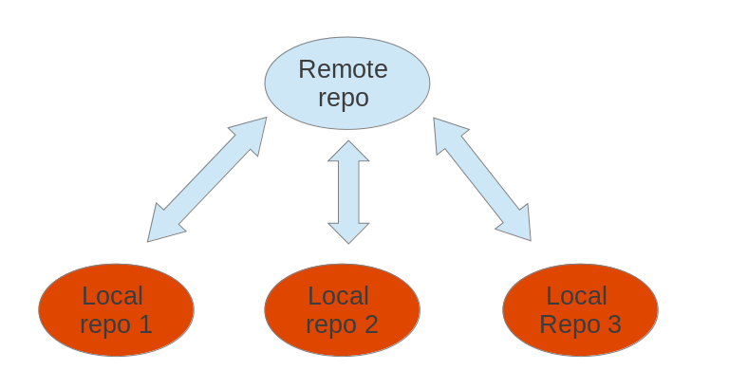
Git

Slide 3
How to work with GIT

Slide 4

Setting up a repository
git init
//OR
git clone <repo>
//OR
git clone <repo> <directory>

Slide 5

Saving Changes
git add <file>
git add <directory>
git commit -m <message>
git push

Slide 6

Inspecting a repository
git status
git log
git log -n limit
git log <file>

Slide 7

Checkout a File, a Commit or a Branch
git checkout master
git checkout HEAD
git checkout <commit> <file>
git checkout <commit>

Slide 8

git revert
git revert <commit>

Slide 9
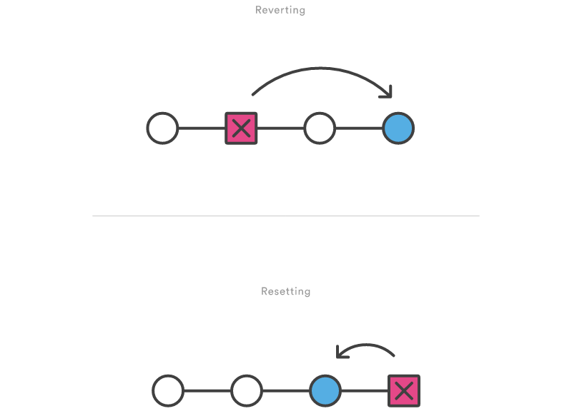
git reset
git reset <file>
git reset <commit>

Slide 10

Syncing
git remote -v
git remote add <name> <url>
git remote rm <name>
git remote rename <old-name> <new-name>
Example:
git remote add john http://dev.example.com/john.git

Slide 11
Git fetch
The git fetch command imports commits from a remote repository into your local repo
git fetch <remote>
git fetch <remote> <branch>
Example:
git fetch origin
git checkout master
git log origin/master
git merge origin/master

Slide 12
Git pull
Fetch the specified remote’s copy of the current branch and immediately merge it into the local copy.
git pull <remote>

Slide 13
Git push
git push <remote> <branch>
git push <remote> --all

Slide 14
gitignore

Slide 15
What we did not explained
Merging
Branching
Making a pull request
Rebase

